Slide 1
Customer Journey Mapping
A Study of Customer Experience on Myntra
Internship Project
B S CHANNABASAPPA FIRST GRADE COLLEGE
PREPARED BY:
SYED ABDUL ADEEB
INTERNSHIP ORGANIZATION:
GLOW LOGIC

Slide 2
Contents
Introduction
Objectives
Awareness
Consideration
Purchase
Delivery
Post-Purchase
Retention

Slide 3
Introduction to Customer Journey Mapping
What is Customer Journey Mapping?
Customer Journey Mapping is a visual representation of the different stages a customer goes through while interacting with a brand.
It helps businesses understand:
Customer needs and expectations
Customer interactions with the brand
Customer emotions at different stages
Pain points and challenges
Opportunities to improve customer experience

Slide 4
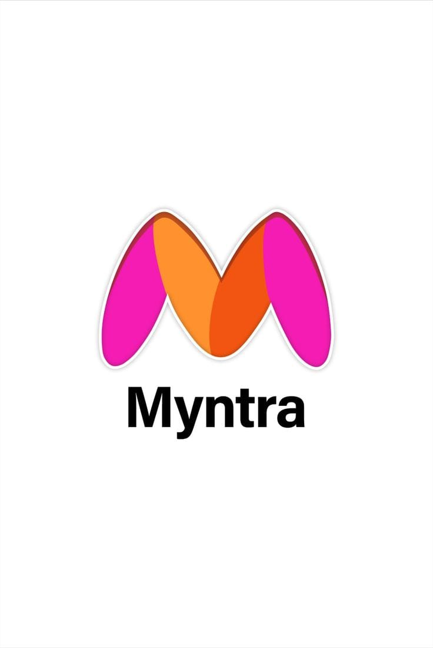
About Myntra
Myntra – E-commerce Fashion Platform
Myntra is an Indian online fashion and lifestyle shopping platform offering products across categories such as:
👕 Clothing
👟 Footwear
👜 Accessories
💄 Beauty & Personal Care
🏠 Lifestyle products

Slide 5
Key Features
Mobile app and website shopping
Wide range of brands and products
Product search and filters
Customer reviews and ratings
Multiple payment options
Order tracking
Return and exchange services

Slide 6
Objectives
To understand the customer's journey while shopping on Myntra.
To identify major customer touch points.
To understand customer expectations and emotions.
To identify pain points during the shopping process.
To analyze opportunities for improving customer experience.
To understand factors influencing purchase and repeat usage.
Research Focus
Customer → Interaction → Experience → Pain Point → Improvement

Slide 7
Customer Journey Overview
1. Awareness
2. Consideration
3. Purchase
4. Delivery
5. Post-purchase
6. Retention
• Customer goal: discover a suitable fashion product with confidence.
• Business goal: reduce friction at every touch point and encourage repeat purchases.
• Primary channels: social media, app/website, product pages, checkout, delivery tracking, returns and loyalty engagement.

Slide 8
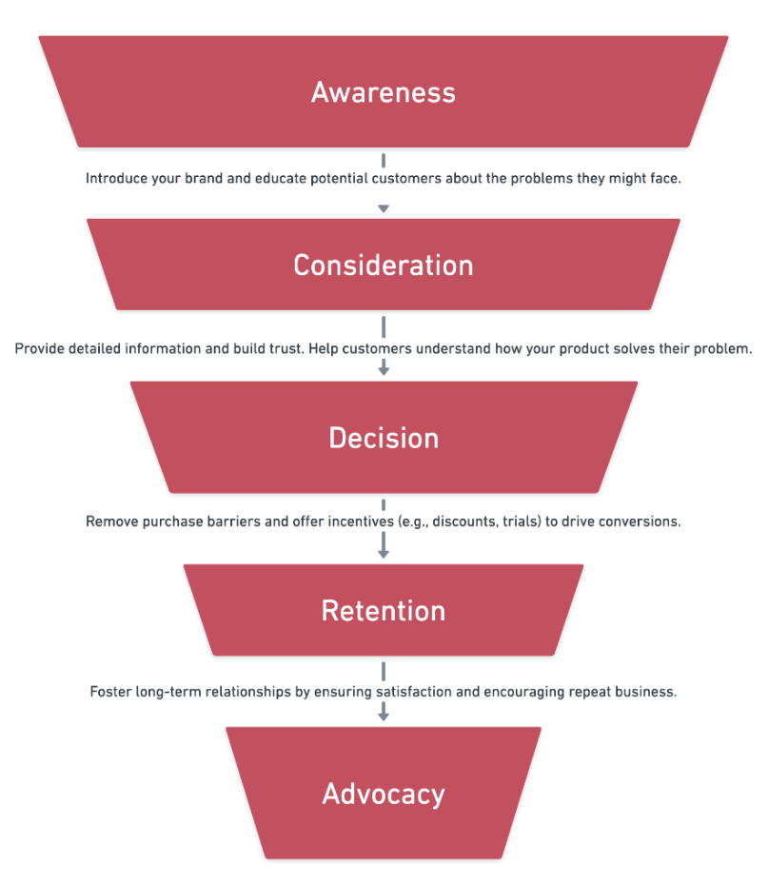

Slide 9
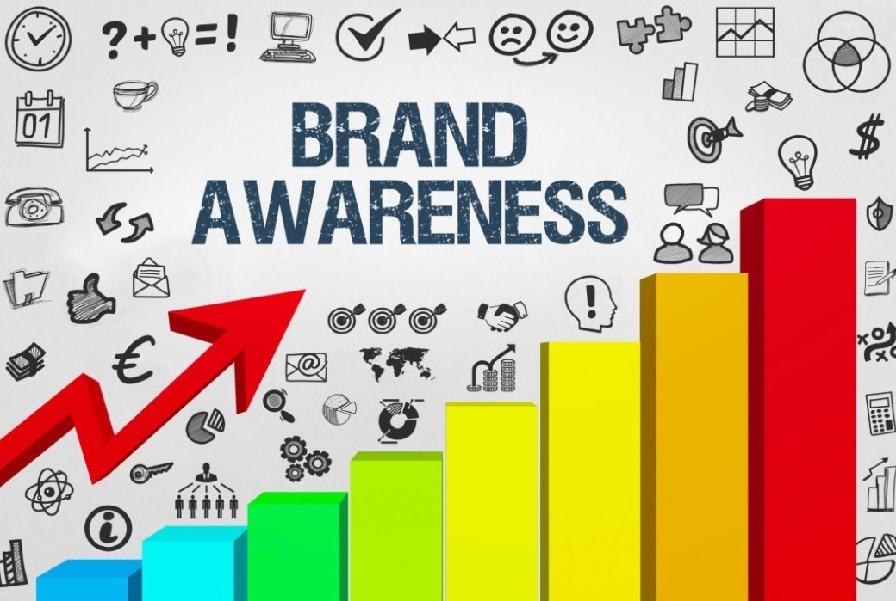

Slide 10
1. Awareness
Customer Goal
Discover fashion products and brands.
Customer Actions
Sees advertisements
Encounters social media content
Searches for fashion products online
Receives promotional notifications
Hears about Myntra from friends/family

Slide 11
Touch points
Instagram/social media
Google/search engines
Myntra advertisements
Influencers
Promotional campaigns
Word of mouth
Possible Pain Points
Too many advertisements
Promotional messages may not always be relevant
Difficulty remembering specific offers

Slide 12
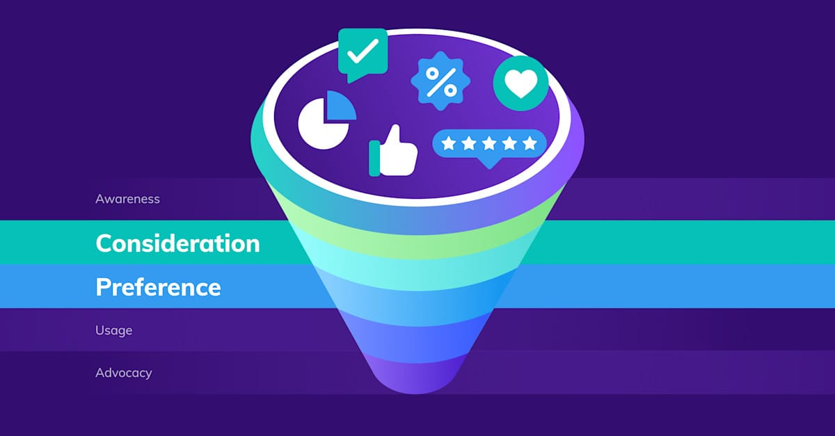

Slide 13
2. Consideration
Customer Goal
Find the right product at the right price.
Customer Actions
Opens Myntra app/website
Searches for products
Applies filters
Checks product images
Reads reviews and ratings
Compares prices
Checks size availability
Reviews delivery information

Slide 14
Touch points
Search bar
Product pages
Filters
Reviews & ratings
Size guide
Product recommendations
Pain Points
Too many choices
Size/fit uncertainty
Product may look different from expectations
Difficulty comparing similar products

Slide 15
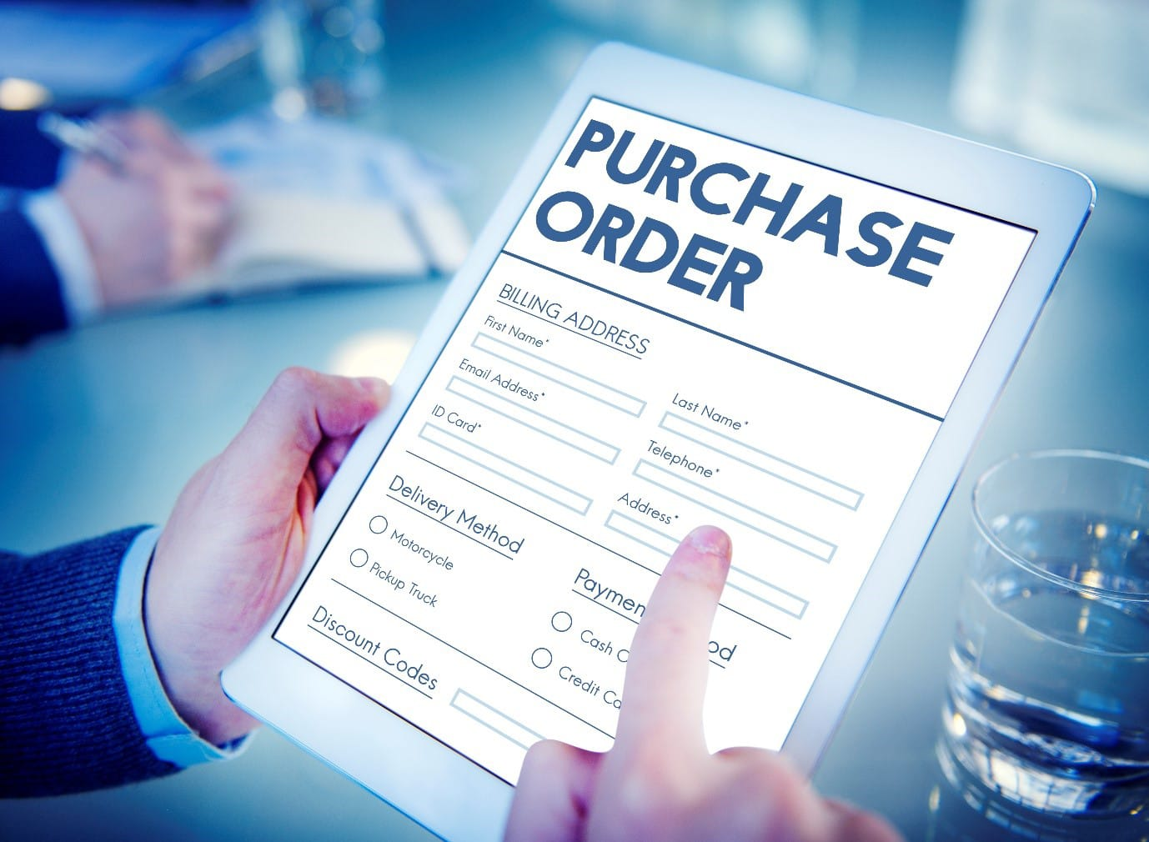

Slide 16
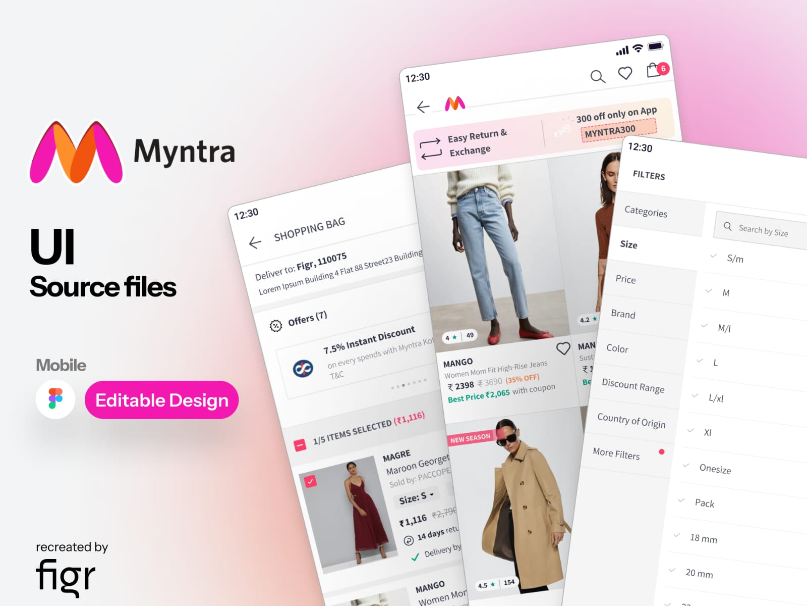
3.Purchase
Customer Goal
Complete the purchase quickly and securely.
Customer Actions
Selects size/color
Adds product to cart
Applies coupon
Reviews final price
Enters/selects delivery address
Chooses payment method
Places order

Slide 17
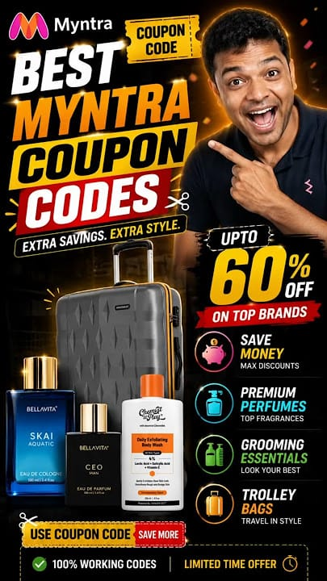
Touch points
Product page
Shopping cart
Coupons
Checkout page
Payment gateway
Order confirmation
Pain Points
Coupon restrictions
Unexpected charges
Payment failures
Complicated checkout
Product becoming unavailable

Slide 18
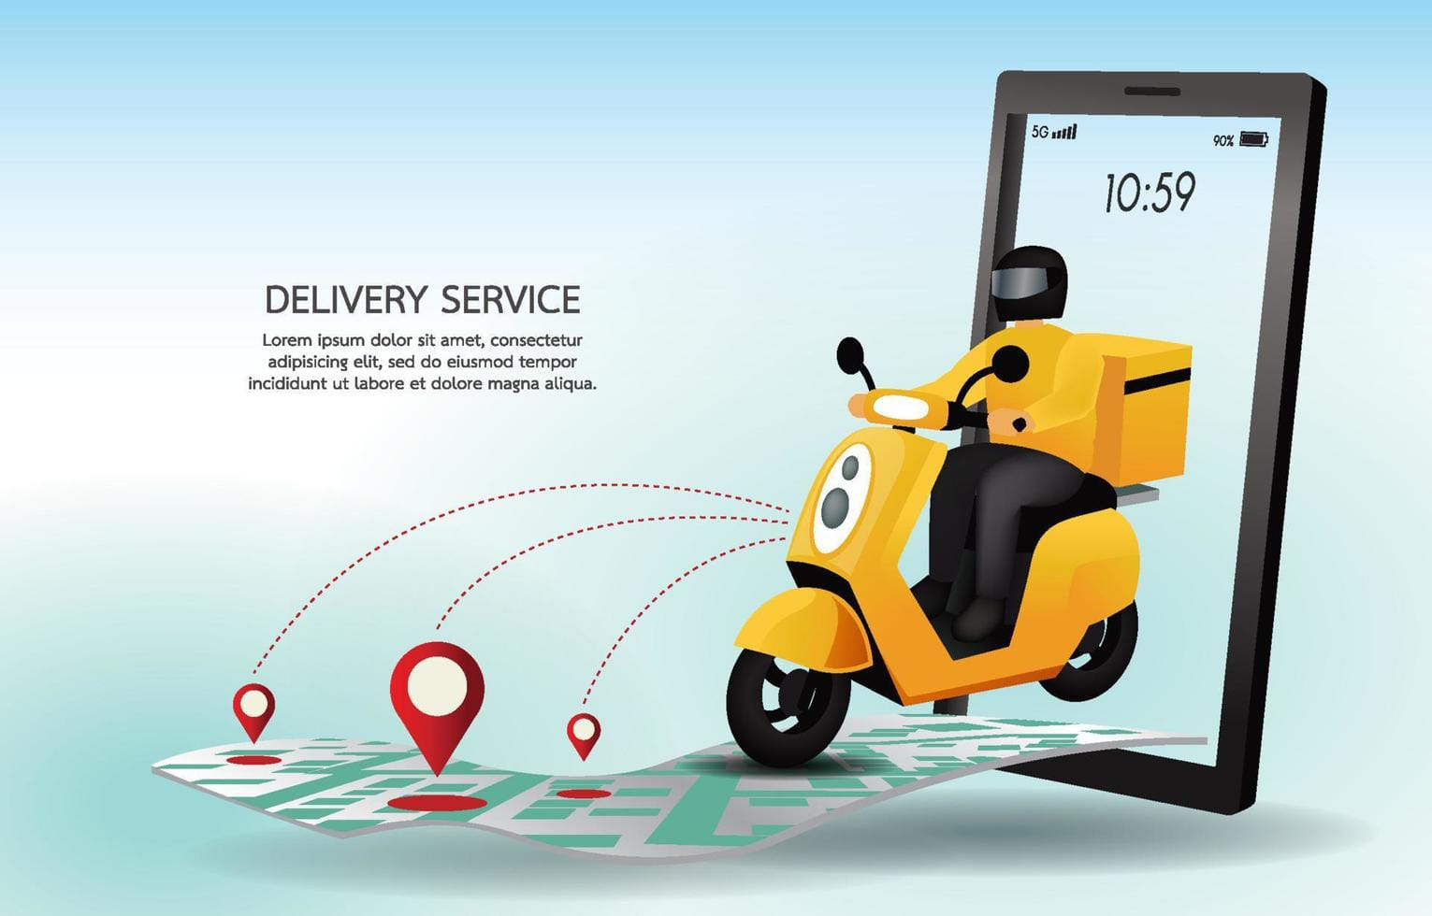

Slide 19
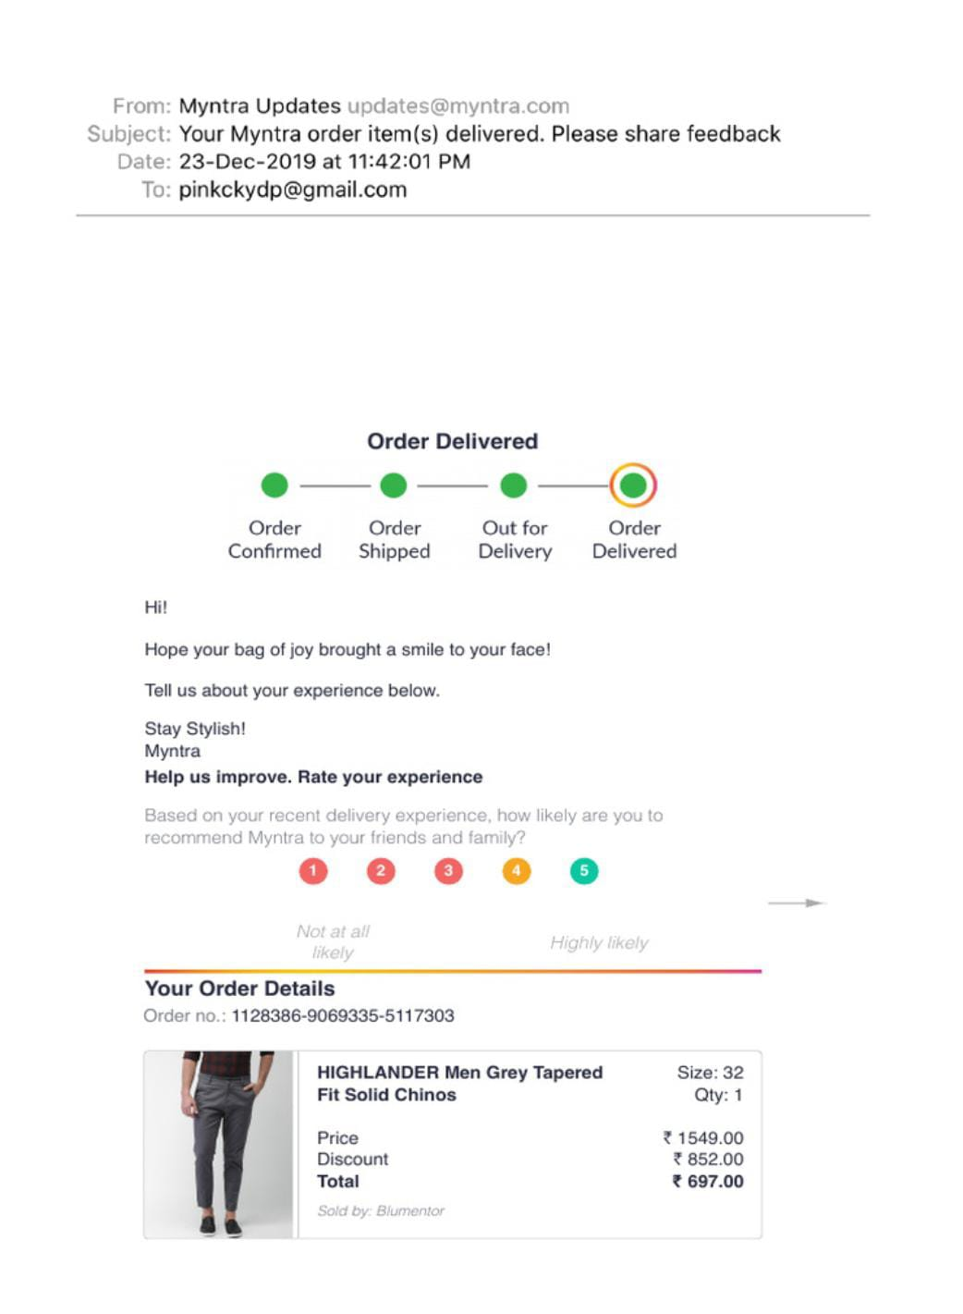
4. Delivery
Customer Goal
Receive the correct product on time.
Customer Actions
Receives order confirmation
Tracks shipment
Receives delivery notifications
Receives package
Opens and checks product

Slide 20
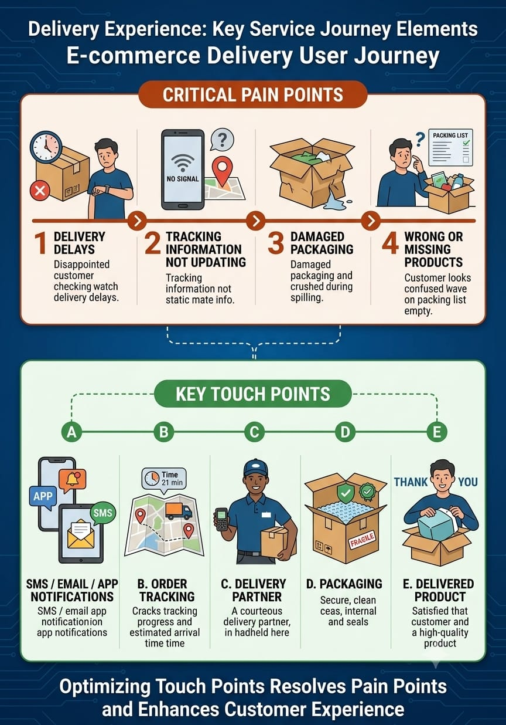

Slide 21
Pain Points
Delivery delays
Tracking information not updating immediately
Damaged packaging
Wrong or missing products
Touch points
SMS/email/app notifications
Order tracking
Delivery partner
Packaging
Delivered product

Slide 22
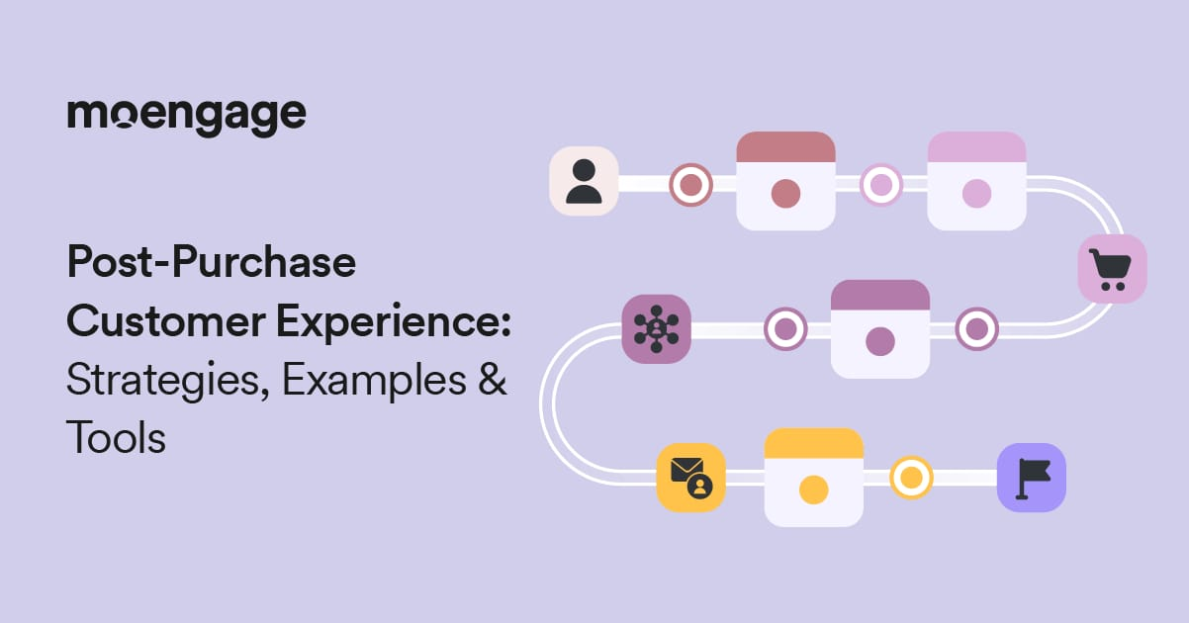

Slide 23
5. Post-Purchase
Customer Goal
Be satisfied with the product and resolve issues easily.
Customer Actions
Uses the product
Checks product quality
Gives rating/review
Contacts customer support if necessary
Requests return/exchange when required

Slide 24
Touch points
Product
Review section
Return/exchange process
Customer support
Refund system
Pain Points
Return/exchange process
Refund waiting time
Product quality concerns
Customer support issues

Slide 25
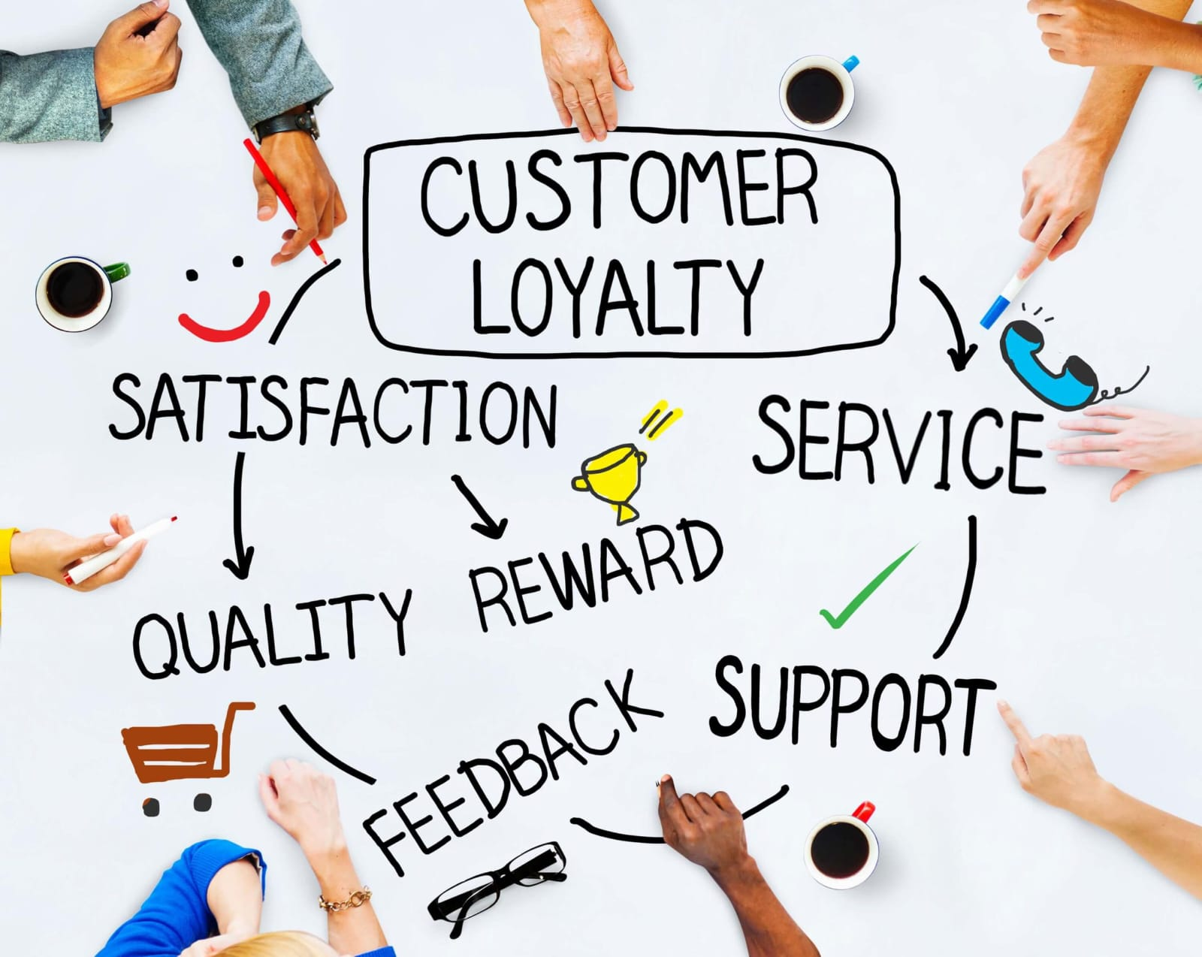

Slide 26
6. Loyalty & Customer Retention
Customer Goal
Find useful products and enjoy a convenient shopping experience.
Customer Actions
Returns to the app
Searches for new products
Uses personalized recommendations
Responds to offers
Purchases again
Recommends the platform to others

Slide 27
Touch points
Personalized homepage
Notifications
Offers and discounts
Recommendations
Loyalty/benefit programs
Social media
Pain Points
Return/exchange process
Refund waiting time
Product quality concerns
Customer support issues

Slide 28
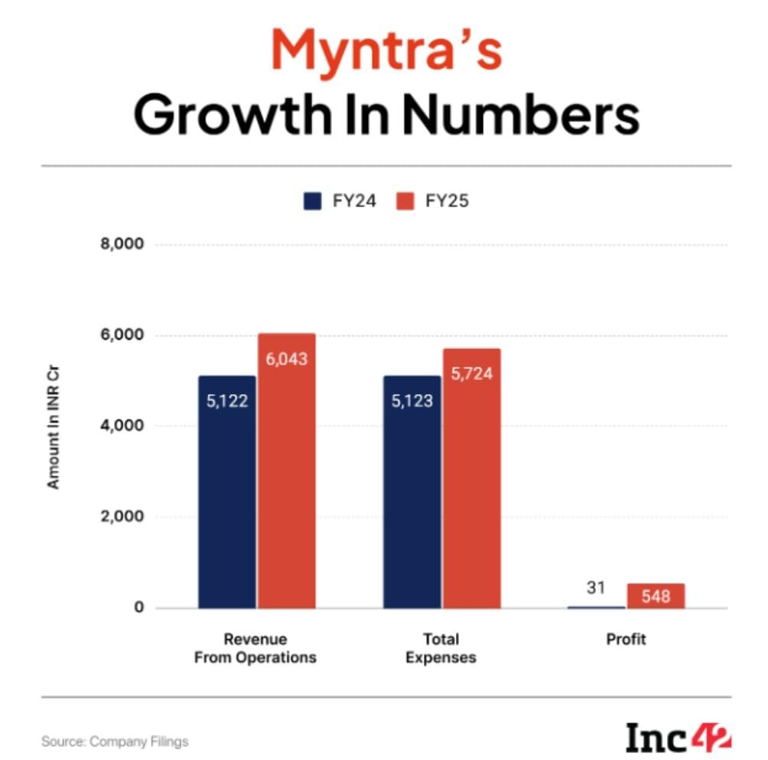

Slide 29
STRATEGIC GROWTH PLAN
1. Personalization
AI-driven product recommendations
Personalized home page and offers
Recommendations based on browsing and purchase behavior
2. Customer Experience
Simplify search, filters and checkout
Improve size/fit guidance
Make returns and exchanges easier to understand
3. Customer Retention
Strengthen Myntra Insider benefits
Personalized offers for returning customers
Reward repeat purchases and engagement

Slide 30
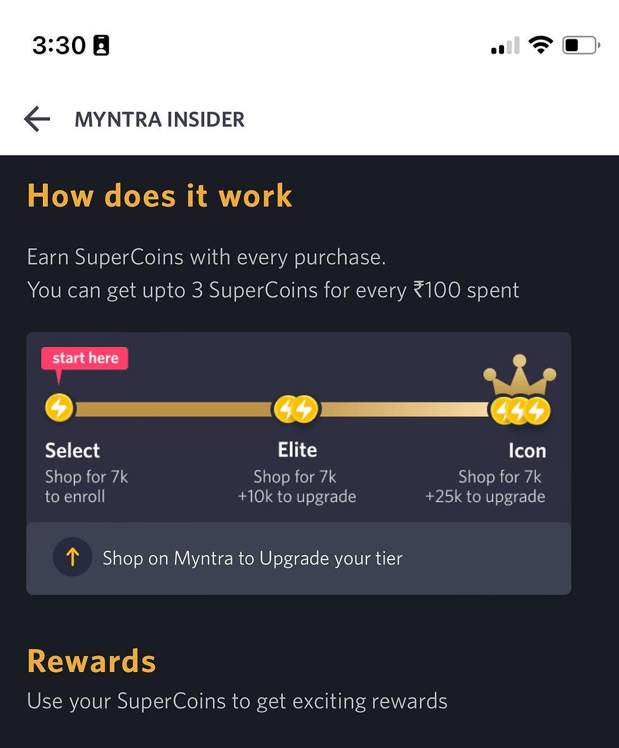
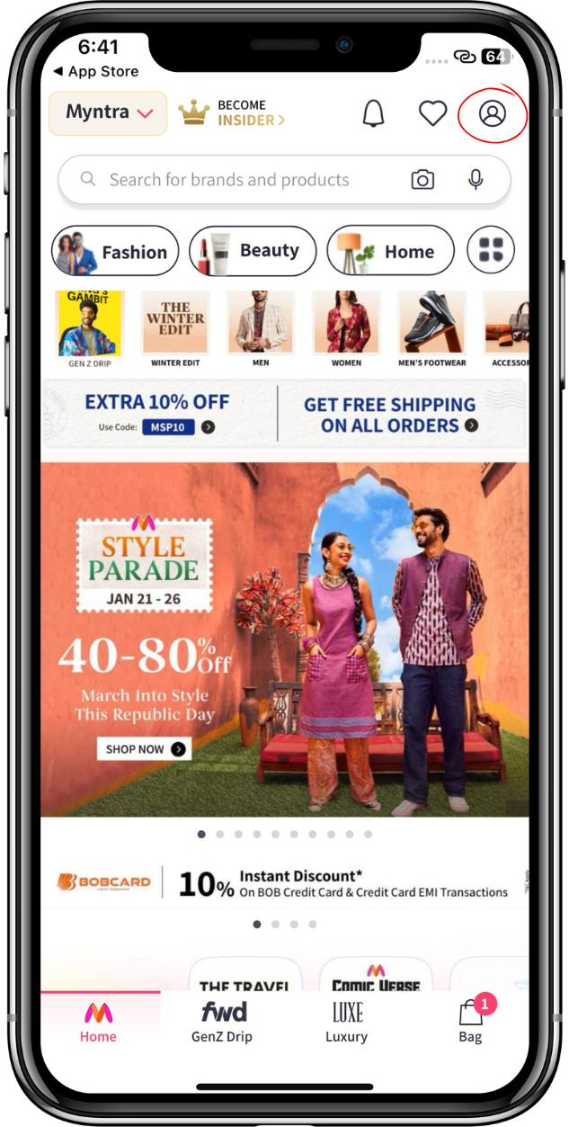

Slide 31
4. Omnichannel & Engagement
Connect app, website and social-media experiences
Use short-form fashion content for product discovery
Collaborate with relevant creators and fashion communities
Growth Plan
Short Term → Medium Term → Long Term
0–6 Months: Improve UX, search, size guidance & checkout
↓
6–18 Months: Expand personalization & retention initiatives
↓
18+ Months: Build deeper AI-driven fashion discovery and customer engagement

Slide 32
Recommendations
Customer Challenge | Recommendation | Expected Benefit
Too many product choices | Smarter filters & AI recommendations | Faster discovery
Size/fit uncertainty | Improve size & fit recommendations | Greater purchase confidence
Checkout friction | Simplify checkout | Easier purchase completion
Delivery uncertainty | More transparent tracking | Better customer confidence
Return concerns | Simplify return/exchange communication | Reduced customer frustration
Irrelevant promotions | Personalized offers | More relevant engagement

Slide 33
CONCLUSION
Customer experience is influenced by every touch point, not only the purchase.
Product discovery and personalization can make shopping more relevant.
Clear product information and size guidance can improve purchase confidence.
A smooth checkout and transparent delivery experience can reduce friction.
Easy returns, responsive support and loyalty initiatives can strengthen long-term engagement.

Slide 34
